Slide 1
Quantum-security of commitment schemes and hash functions
Dominique Unruh
University of Tartu

Slide 2
Surprises with hash functions
Consider a hash function and a horse race
“Spicy Spirit” wins…
Player
$$H("spicy spirit", 231632)$$
Bookie
Player
$$231632$$
Bookie
$$$

Slide 3
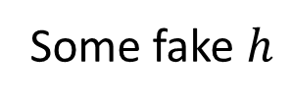
Surprises with hash functions (II)
Consider a cheating player
“Wallopping Waldo” wins…
Player
$$H("spicy spirit", 231632)$$
Bookie
Some fake $h$
Player
$r$ with $H\left(wallop,r\right)=h$
Bookie
$$$

Slide 4
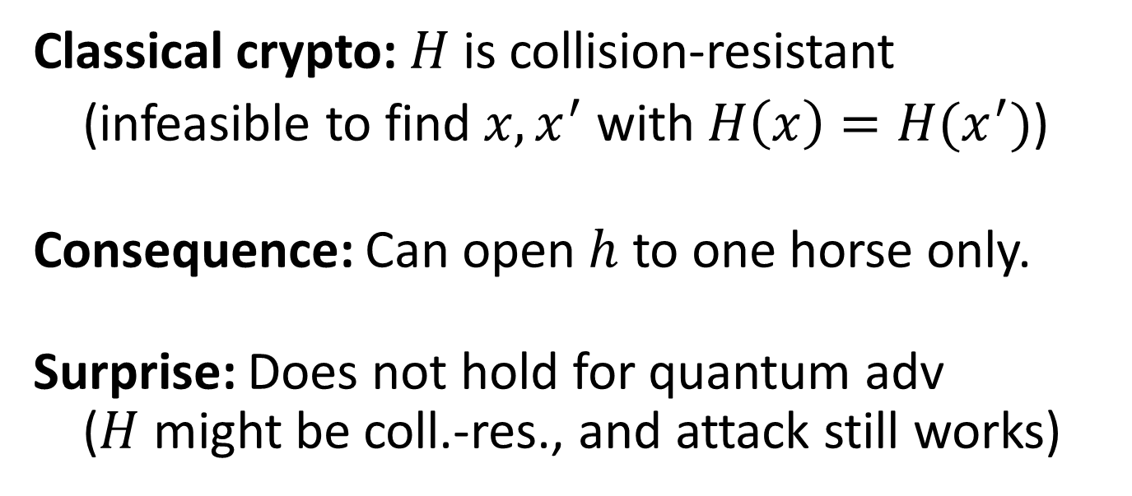
Surprises with hash functions (III)
Player
$r$ with $H\left(wallop,r\right)=h$
Bookie
Classical crypto: $H$ is collision-resistant
(infeasible to find$x,x^{′}$ with $H\left(x\right)=H(x^{′})$)
Consequence: Can open $h$ to one horse only.
Surprise: Does not hold for quantum adv ($H$ might be coll.-res., and attack still works)

Slide 5
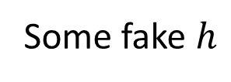
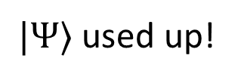
Surprises with hash functions (IV)
Player
Some fake $h$
Bookie
$$|Ψ〉$$
Player
$r$ with $H\left(wallop,r\right)=h$
Bookie
$|Ψ〉$ used up!
“Commitment”: A protocol that does not allow the player to change their mind. → This talk.

Slide 6
Commitments: scope of this talk
Hiding and binding
Hiding seems well understood
Statistically vs. computationally binding
Weaker assms, everlasting security
Interactive vs. non-interactive
For simplicity
Secure against quantum attacks
Classical protocols

Slide 7
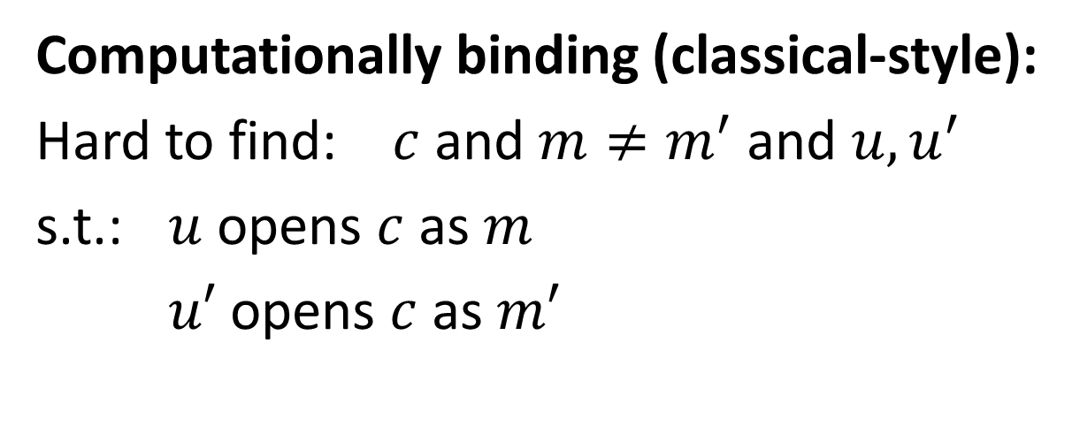
Classical definitions
$$c$$
Commit:
S
R
$$m, u$$
Open:
Computationally binding (classical-style):
Hard to find: $c$ and $m≠m^{′}$ and $u,u^{′}$
s.t.: $u$ opens $c$ as $m$
$u′$ opens $c$ as $m′$
$⟹$ Adv. cannot change his mind

Slide 8
New definitions needed
Classical def of computationally binding:
“Walloping Waldo” attack still possible!
Collision-resistance
Weaker than expected
Stronger def? (NIST post-quantum competition?)
Our proposal: “Collapse-binding” commitments
Our proposal: “Collapsing” hash functions

Slide 9
Existing defs (binding)
Various prior def’s
Brassard, Crépeau, Damgård, Dumais, Fehr, Jozsa, Langlois, Lunemann, Mayers, Salvail, Schaffner
Various problems:
Need trapdoors (or even UC)
Rewinding proofs difficult
No parallel composition
Do not imply knowledge of message

Slide 10

Collapse-binding commitments
Adv. A outputs commitment $c$ (classically), and valid openings $m,u$ (in superposition)
Def: Collapse-binding = A cannot distinguish
$$|m〉$$
$$|m〉$$
A
A
A
measure
A
or
$$|u〉$$
$$|u〉$$
$$c$$
$$c$$

Slide 11
Why this def?
Intuition:
Adversary cannot produce several openings in superposition
If he could, he’d notice measurement
Formally:
Weaker than “non-existence of two openings” (perfect)
Stronger than “hard to find two openings” (class.-style)
kind of…
$$|m〉$$
$$|m〉$$
measure
A
A
A
A
$$|u〉$$
or
$$|u〉$$
$$c$$
$$c$$

Slide 12
Properties
Perfect binding $⟹$ collapse-binding $⟹$ classical-style binding
Avoids “change of mind”
Composes in parallel
Rewinding friendly
gives ZK arguments of knowledge
Simple constructions from “collapsing” hashes
✔
✔
✔
✔
✔

Slide 13
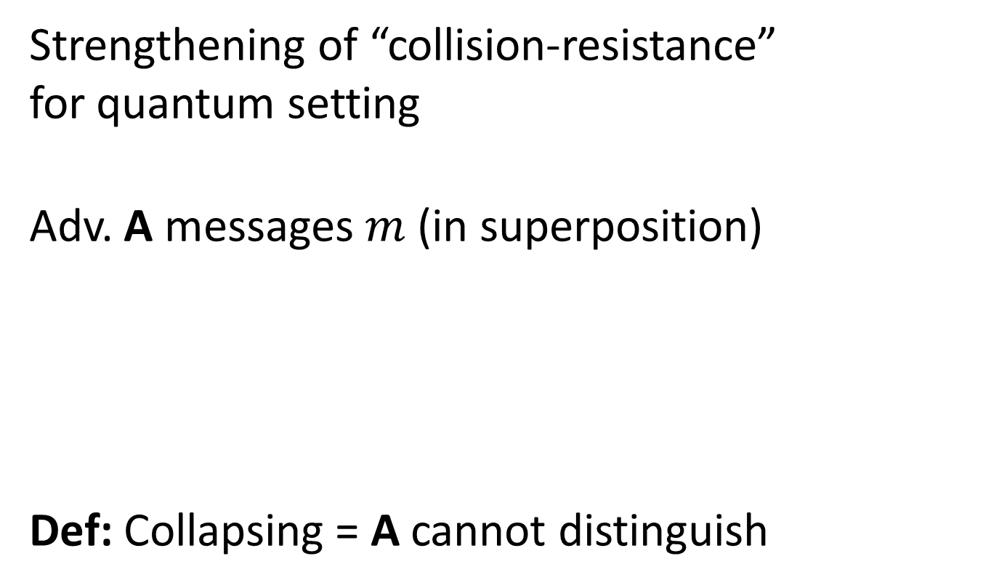
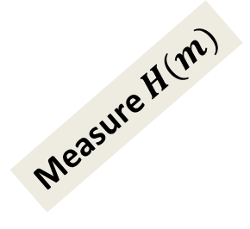
Collapsing hash functions
Strengthening of “collision-resistance” for quantum setting
Adv. A messages $m$ (in superposition)
Def: Collapsing = A cannot distinguish
$$|m〉$$
$$|m〉$$
A
Measure $m$
A
or
A
Measure $H(m)$
A

Slide 14
Collapsing hash functions (ctd.)
Simple “collapse-binding” commitments
Statistically hiding
Using collapsing hashes in existing constructions
Drop in replacement for “collision-resistance”?
Random oracle is a collapsing hash
Suggestion: “Collapsing” required property for hashes
e.g., NIST post-quantum crypto competition

Slide 15
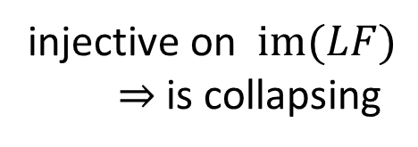
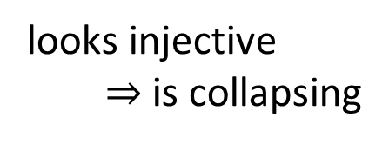
Collapsing hash funs – constructions?
Lossy function (LF):
Indistinguishable whether injective, or highly non-injective (“lossy”)
LF
universal hash func
message
… long …
hash
looks injective
$⇒$ is collapsing
injective on $im(LF)$
$⇒$ is collapsing

Slide 16
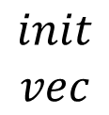
Hashing long messages?
Prior construction: Fixed compression factor (e.g., 2)
For long messages: Merkle-Damgård
$$init$$
$$vec$$
$$H$$
$$H$$
$$H$$
$$H$$
$$hash$$
$${msg}_{1}$$
$${msg}_{2}$$
$${msg}_{3}$$
$$padding$$

Slide 17
Summary
Classical definitions for commitments & hashes: insufficient!
New definitions: collapse-binding / collapsing
Constructions from lossy functions / lattice-assumptions
Question: Collapsing hashes from OWF / coll.-resistance?

Slide 18
I thank for your attention
This research was supported by European Social Fund’s Doctoral Studies and Internationalisation Programme DoRa

